Slide 1

NATIONAL INSTITUTE OF TECHNOLOGY AGARTALA DEPARTMENT OF ELECTRONICS AND COMMUNICATION ENGINEERING Mini-Project Presentation By, Group No. 19
UNDER THE SUPERVISION OF:
Dr. Apangshu Das
Assistant Professor,
ECE, NIT Agartala
Presented By:
Girishankar J, 19UEC077
Anagha Raj K R, 19UEC070
Sonam Singh, 19UEC117
Rakesh Kumar Sah, 19UEC075

Slide 2
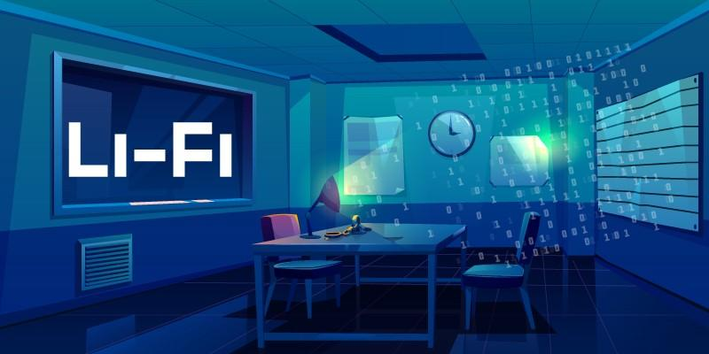
Laser
Topic
Li-Fi
Data Transmission

Slide 3
CONTENTS
Introduction
Need For Li-Fi
History
Implementation of Li-Fi System
Applications
Advantages
Limitations
Conclusion

Slide 4

Introduction
What is Li-Fi?
Light-Fidelity
Light based Wi-Fi
Li-Fi is a wireless communication technique which utilizes light to transmit data between two devices
Transceiver fitted LED lamps acts e Wi-Fi modems
Provides illumination as well as data communication

Slide 5

LASER LI-FI
Advanced version of Li-Fi
LED’s are replaced by lasers
Laser beams are being used to transmit data
The on-off activity of laser is faster in comparison to LED’s which provides faster response.

Slide 6
LASERS OVER LED’S
Response is faster than LED’s
Produce coherent and directed light beam, thereby reducing the chances of interference with other signals
Higher bandwidth
Faster data transmission rate

Slide 7
NEED FOR LI-FI
Issues Regarding Radio Spectrum
Radio spectrum is congested, but the need for wireless data doubles each year
Issues regarding radio spectrum such as capacity, availability, efficiency, security are solved using Li-Fi
Speed of data transmission can be increased
Capacity
Availability
Efficiency
Security

Slide 8
OVERCOMING WI-FI ISSUES
CAPACITY
Spectrum is 10,000 times greater than that of radio frequency
EFFICIENCY
Highly efficient since LED consumes less energy
AVAILABILITY
Light waves are available everywhere.
SECURITY
Cannot penetrate through walls. Hence data cannot be intercepted.

Slide 9
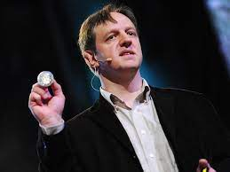
HISTORY OF LI-FI
The technology truly began during the 1990's in countries like Germany, Korea, and Japan where they discovered LED's could be retrofitted to send information.
The term Li-Fi was coined by Professor Harald Haas, from the University of Edinburgh, UK.
He introduced and demonstrated this technology in his 2011 Ted Talk, “Wireless data from every light bulb”.
He formed a company named PureLiFi for development of Li-Fi technology
In October 2011, companies and industry groups formed the Li-Fi Consortium, to promote high-speed optical wireless systems.
Professor Harald Haas

Slide 10
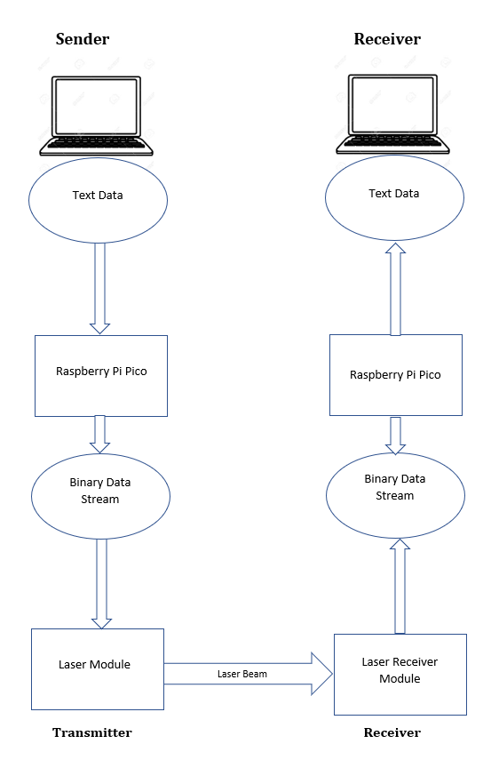
PROPOSED SYSTEM ARCHITECTURE
Proposed Li-Fi system consists of two parts:
Transmitter Circuit
Receiver Circuit
Data to be transmitted is encoded into binary bits by the microcontroller, Raspberry Pi Pico
Binary data stream is transmitted as laser beam using laser module
Receiver circuit extracts data from laser beam using laser receiver module
The binary data is decoded back to text data by the microcontroller in receiver circuit

Slide 11
WORKING PROCESS
Operational procedure is very simple
If the laser is on, you transmit a digital ‘1’, if its off you transmit a ‘0’.
Laser light varies in intensity so fast that human eye cannot detect it
A controller connected before the laser is used to code data
We have to just vary the rate at which the laser flicker depending upon the data we want to encode
Thus every light source will works as a hub for data transmission .

Slide 12
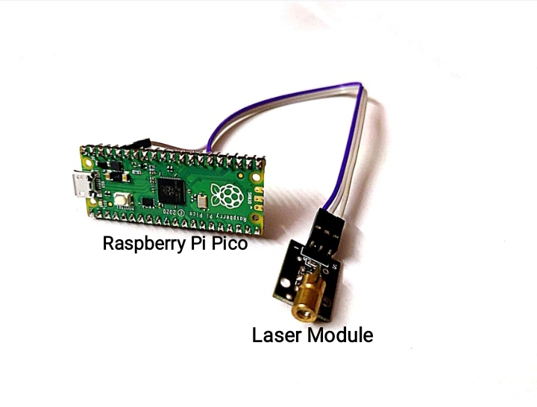
TRANSMITTER CIRCUIT
Consists of light emitting source(Laser Module) and microcontroller(Raspberry Pi Pico)
Text to be transmitted is typed to source like PC/Laptop
Raspberry Pi Pico converts the text into its corresponding binary values
Binary bits are transmitted using pulsating laser diode
When laser is ‘ON’, it transmits bit ‘1’
When laser is ‘OFF’, it transmits bit ‘0’
Uses Modified ON-OFF Model of Transmission
To synchronize transmitter and receiver circuit and to avoid time delay, we add ‘Start’ bit for every bit

Slide 13
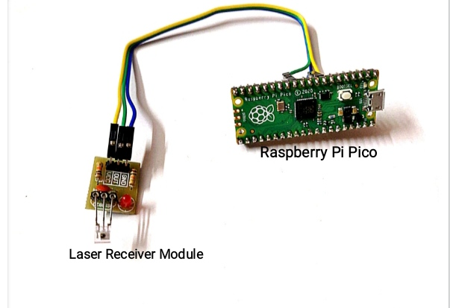
RECEIVER CIRCUIT
Consists of a laser non modulator tub sensor receiving module and a Raspberry Pi Pico
Laser receiver module detects laser beam and extracts the binary data from it
Whenever sensor detects a laser beam, sensor output goes high, i.e, sensor inputs ‘1’ to microcontroller
Otherwise, sensor inputs ‘0’ to microcontroller
Raspberry Pi Pico processes the received bit stream and converts it back to text data
The decoded data can be displayed on an LCD/PC

Slide 14
RESULT
Laser Li-Fi can be used for faster, efficient and secure transmission of data.
Data is transmitted asynchronously between source and receiver.
Time delay caused during transmission and reception of data do not cause any drift in the received data.
Successful reception of information without any loss is achieved.
This technology can be further extended for the transmission of images, audios and videos.

Slide 15
APPLICATIONS
Li-Fi can be used in
Sensitive areas such as aircrafts for data transmission without causing interference
Places where it is difficult to lay optical fibres like operation theaters
Traffic scenarios, thereby reducing accidents
Underwater applications where radio waves cannot propagate
Green information technology
Smarter power plants

Slide 16
Interstellar Communication
The power for an average laser pointer is a measly 0.005 watts. Even though, the narrow beam will spread out over long distances. Around 100 meters away from a red laser pointer, its beam is about 100 times wider and looks as bright as a 100-watt light bulb from 3 feet away. Viewed from an airplane 40,000 feet in the air assuming there’s no clouds or smog the pointer would be as bright as a quarter moon. From the International Space Station, it would fade to roughly as bright as the brightest star in the night sky.

Slide 17
Interstellar Communication
So instead of using Powerful, Costly and complex Signal generator for generating GHz range of radio waves which has the power to penetrate the Ionosphere but have the higher chance of getting absorbed by the atmospheric gases, It is possible to simply use a modified laser of considerably lower power range

Slide 18
ADVANTAGES
Data rate greater than 10 Gbps; Theoretically allowing HD film to be downloaded in 30 seconds
Can be used anywhere, even in RF restricted areas
Power consumption is less
Cost efficient.
As light waves cannot penetrate through walls, the data cannot be intercepted; Thus provides secured communication.
Efficient alternative to radio based wireless; since it is quick and reliable.

Slide 19
LIMITATIONS OF LI-Fi
Presence of light is essential
Line of sight should be maintained
Works better with fluorescent lights, lasers and LEDs but very low efficiency with bulbs
Visible light cannot penetrate through solid objects.
Interferences from external light sources like sunlight, in the path of transmission will cause interruption in the communication.
Data transmission can be easily blocked by any object placed in front of LED source.

Slide 20
CONCLUSION
The possibilities are numerous and can be explored further
Thus, if Li-Fi technology can be put into practical use, every bulb can be used as an alternative to Wi-Fi hotspots.
It provides simple, faster and efficient wireless data communication.
Li-Fi will make us to proceed towards the cleaner, greener, safer and brighter future.

Slide 21
THANK YOU

